Slide 1
Integer data type
Python full stack

Slide 2
1. int
Int is a one of tha pre-defind Class and Treated as Fundamental Category Data Type.
The purpose of int data type is that "To store Integer Data OR Whole Numbers OR Integral Values (Values without Decimal Places)" such as empno,stno,htno,adcno,accno...etc

Slide 3
Example :
Python Instructions Outputs
>>> a=100
>>> print(a)-------------------------------100
>>> id(a)------------------------------140719971233800
>>> print(id(a))----------------------140719971233800
>>> print(a,id(a))------------------100 140719971233800
>>> type(a)-----------------------------<class 'int‘>
> >> print(a,type(a),id(a))--------100 <class 'int'> 140719971233800

Slide 4
Example -2
>>> a=100
>>> b=200
>>> c=a+b
>>> print(a,type(a),id(a))------100 <class 'int'> 140719971233800
>>> print(b,type(b),id(b))-------200 <class 'int'> 140719971237000
>>> print(c,type(c),id(c))-------300 <class 'int'> 2397157252624

Slide 5
By using 'int' data type, we can store Different Types of Number System Values. They are
Decimal Number System
2. Binary Number System
3. Octal Number System
4. Hexa Decimal Number System

Slide 6
Base Conversion Functions in Python
The Process of the Converting one Base Value into Another Base Value is called Conversion Functions.
In Python Programming, we have 3 base Conversion Functions. They are
1. bin()
2. oct()
3. hex()
Notes:
Base Conversion Functions in Python

Slide 7
1. bin()
This bin() is used for Converting Decimal, Octal and Hexa Decimal values into Binary Data
Syntax: varname=bin( Decimal / Octal / Hexa )
Examples:-
>>> a=15
>>> b=bin(a) # Dec to Bin
>>> print(b)--------------------0b1111
>>> print(b,type(b))---------0b1111 <class 'str'>
>>> b-----------------------------'0b1111'

Slide 8
Example (bin)
>>> a=0o17
>>> b=bin(a) # Oct to Bin
>>> print(b)--------------0b1111
>>> a=0xf
>>> b=bin(a) # Hexa to Bin
>>> print(b)------------0b1111

Slide 9
2. oct()
=>The oct() is used for Converting Decimal, Binary and Hexa Decimal values to Octal Data.
=>Syntax:
varname=oct(Decial / Binary / HexaDecimal )
Example :
>>> a=15
>>> b=oct(a) # Decimal to Octal
>>> print(b)------------------0o17

Slide 10
Example oct()
>>> a=0b1111
>>> b=oct(a) # Binary to Octal
>>> print(b)-------------0o17
>>> a=0xF
>>> b=oct(a) # Hexa to Octal
>>> print(b)--------------------0o17
Notes:
Example oct

Slide 11
3. hex()
The hex() is used for Converting Decimal,Binary and Octal into Hexa Decimal Value
Syntax: varname=hex(Decimal / Binary / Octal)
Examples
>>> a=15
>>> b=hex(a) # Decimal to Hexa Decimal
>>> print(b)-------------------0xf
Notes:
3. hex()

Slide 12
Example of hex()
>>> a=0b1111
>>> b=hex(a) # Binary to Hexa Decimal
>>> print(b)----------------------------------0xf
>>> a=0o17
>>> b=hex(a)
>>> print(b)--------------------0xf

Slide 13
Base Conversion Calculator
Decimal to others ()
D to B-------------------bin()
D to O-------------------oct()
D to H-------------------hex()
Binary to others
B to D-------------------Automatic Conversion
B to O-------------------oct()
B to H-------------------hex()
Octal to others
O to D-------------------Automatic Conversion
O to B-------------------bin()
O to H-------------------hex()
Hexa to others
H to D------------------Automatic Conversion
H to B------------------bin()
H to O------------------oct()

Slide 14
NOTE:
>>> a=0489----------------------SyntaxError:
leading zeros in decimal integer literals are not permitted; use an 0o prefix for octal integers
>>> a=489
>>> print(a,type(a))-------------489 <class 'int'>

Slide 15
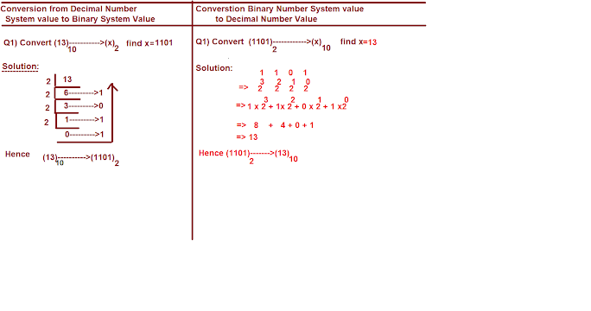
Decimal to binary/binary to decimal

Slide 16
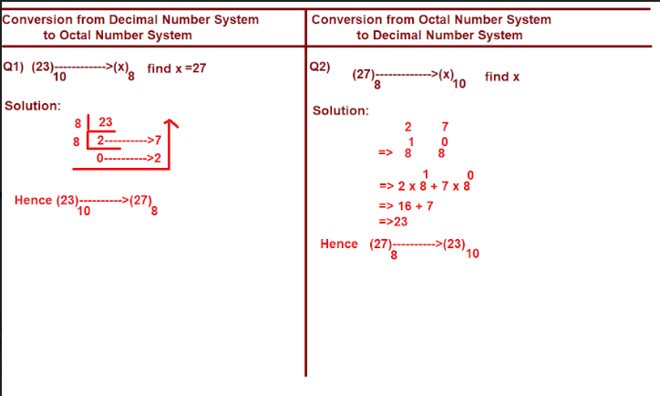
Decimal to octal and octal to decimal

Slide 17
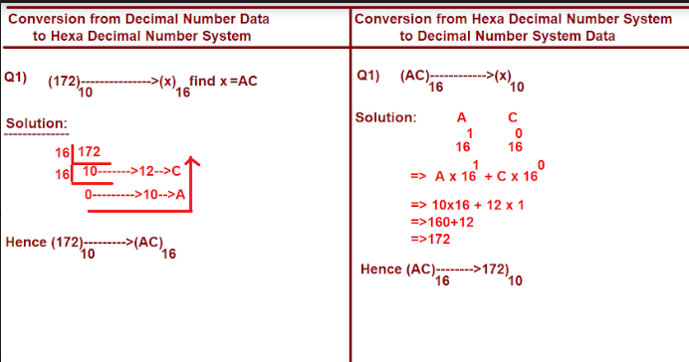
Decimal to hexa and hexa to decimal

